Slide 1
Research led Innovation Incubator.Industry.ProductLabs
Prakash Yalla, Tech Transfer Officer
Prof.Ramesh Loganathan, CIE

Slide 2
The Lab TO Land gap - why not enough products from research
Problems
Real world
Academic
Industry
Publish
Research
Startup
Innovation
New markets
Custom Solution
Project
Social
eGov
Industry
Product
LAB
LAND
Real world?
Whats that?
Research often not connected to realworld problems. Utility may be low
Faculty excited by research. Not by industry nor biz. So who will start?
Understanding of a market need, and aprototype fo rthat need is essential
Faculty? entrepreneur?
Demo? Market prototype?
Right info on what it is , and what it can do for companies rarely present
Research Works
Discover (or commissioned)
Usecases
License
License
Connect
Prototype
Validate

Slide 3
Our Approach: FLIP, Bring markets >TO> research
Productize/ Translate Research
Research.. Starting point
Markets: Identify where opportunities lie
Startups: Think innovation. Think speed
Industry: Best practices & : engineering
Entrepreneurs: Innovators willing to create deep tech products
Makers: Fab Lab- for prototypes
Converge all facets around research..

Slide 4
New Models
Understand why & how research gets translated (or not).
Co-Innovation: research led prototypes
Product seeding: market connected
Domain specific COES
Open Innovation
Study the Innovation process
New tech prototypes companies need. Built jointly by company team and research lab
Research Centers
Product Labs
Tech Transfer
CIE/ Incubator
Maker/Fab Lab
Research Outreach
Company’s innovation enabled- company teams, CIE & Startups.. Come together in PRODUCT LABS
EIR, Maker Lab and Seeding Bootcamps
A domain/vertical focused center, with a set of applied-res projects funded by a company

Slide 5
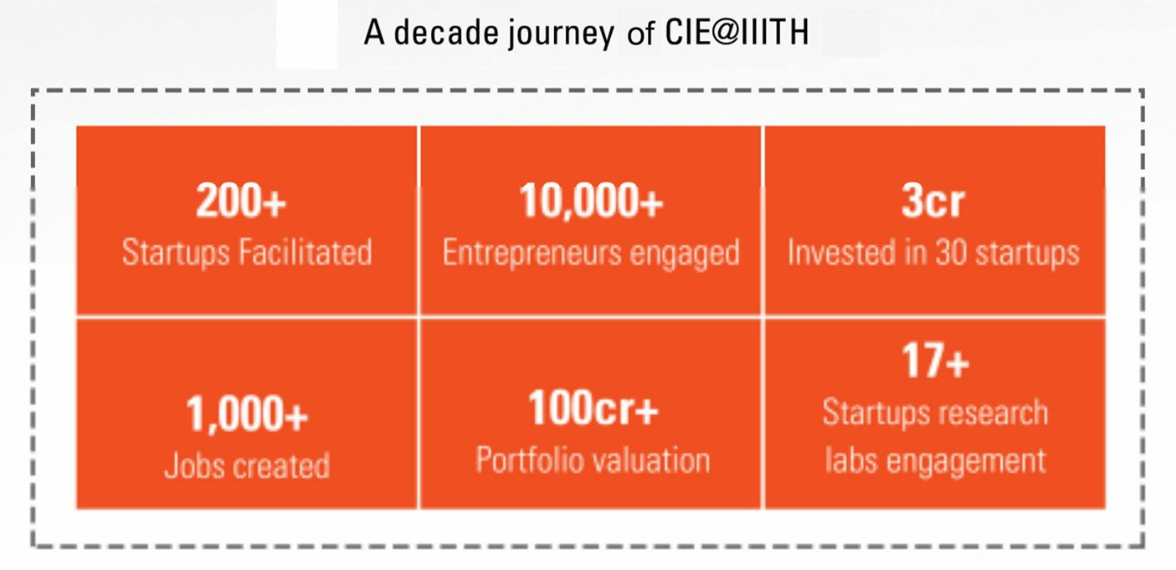
#0: CIE (Center for Innovation & Entrepreneurship) at core
~40 start up
moved to T-Hub

Slide 6
#1 Beyond commissioned research, co-create: Faculty jointly working with Companies & startup
Research insights & Prof/Team
Company problem & team
Co-Innovation (tech concept/ prototypes)
Research works
Market opportunity
Startup & Team
CO-Creation > Deep IP Mkt Product

Slide 7
#2 Open-Innovation model, to solve corp tech challenges
Open Innovation @ IIITH Product labs
Company’s problems
Startup Product- pivoted
Research Inputs
Extended innovation.. Leverage startups & research for Corp Innovation
> Source startups > Enrich the tech > Company uses >
Challenge
Open hackathon
Startups & student innovators
Source
Startups builds out the product in the co-innovation lab
Company use
Connect Research
Company biz mentoring, IIIT deeptech help
Bring deep-tech into the products
Co-innovate
Work with the starup
Specific problem area
Company sponsored
Winning startups/innovators
Faculty and research scholars help in the co-innovation lab
Company to help define and pilot

Slide 8

#3 TTO/Product Labs: Create Market prototypes from research Pre-Incubator Enabling EIRs & Corporate Innovation
Student/Faculty Startup
Market POC & License
Entrepreneur In Residence
Product Labs
Pre-Incubate/Accelerate
Market use cases
Research Labs
Deeptech Startups
Invest/Acquire/Access
Corporate Innovation Programs

Slide 9
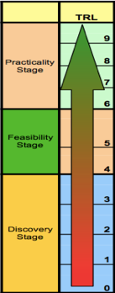
Product Lab: Build Around IIIT-H Research O/P
A market relevant products’ lab to-
Curate & bring Relevant Market/Business Insights
Independent market and business analysis
Define products
Assess market potential, maturity & Visualizes Tech Solutions
Build market prototypes
Enables Market/Licensing Readiness Of Institute Research
Connect to Market targets
Identify “Go To Market” Owner & Collaborate with partnering Corporates/Investors
Downstream Engagement Models
EIR , Corporate Innovation , Social Innovation
TECH READINESS
Industry
Product Labs
Productizing research
Research

Slide 10
Tech Progression : Lab POC to Deployment
Research with potential (TRL3)
Market curated Prototype (TRL6)
Startup Ready with EIR & pilots (TRL7)
Startups incorporated (TRL9)
Research Components
Product Seeding : 3-6 months
Product Scaling : 6 - 9 months
Product engineering & deployment
Lab work > Mkt usecase > Product Labs prototype (&delta research)> validate usecase
MVP > Virtual startup > Startup > seed grant > Customer validation/POcs
take to market (first few paying customers) > Startup gets seed investment (25-50L) to prove scale potential in market.
Could continue as virtual startup

Slide 11
Institute Enablers
Productizing Research Grant
Pre-Product Visualization & nurturing driven by faculty
Applied Research Labs
Living Labs, iHub datasets
Product Labs & Raj Reddy Center for social innovation
Market Enablement and Engineering Market POC
EIR
Enables seeding of startup ie pre-incubator
Research Park Foundation (RPF)
Virtual startup . Institute owned . Revenue . Pre-startup
Startup Engagement (CIE)
Licensing / co-creation
Grants and Funds
EIR, Prayas, Translation grants (ihub, bhashini, living lab, tide etc)

Slide 12
Case Studies

Slide 13
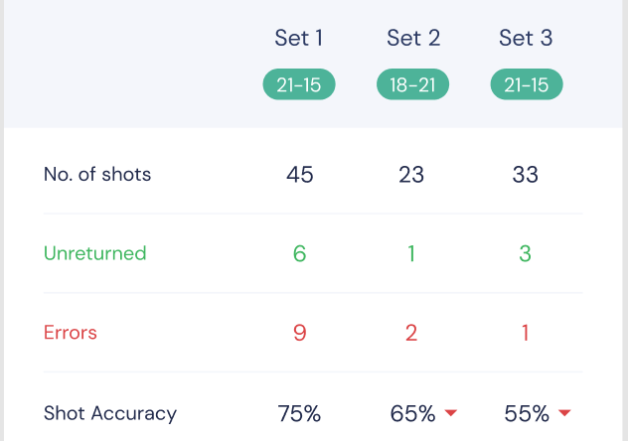








#P1: Product Labs Nurturing & End user engagement (Sports Analytics - Matchday.ai)
PIPELINE
DATA
Broadcast/Camera Feed
Core Algorithm
Real Time
Data Stream
CUSTOMER SEGMENTS
CUSTOMERS
Customer Type | Use with Data | Market Size (ARR)
Professional Teams/Athletes | Gain competitive edge | 1.5 M$
Broadcasters/Leagues | Drive fan engagement | 2 M$
Amateur/Semi Pro Athletes | Mastery of craft | 200 M$
Notes:
Pullela Gopichand (Indian Badminton head coach) : “As such there is no data readily available in the sport of badminton. I usually have 2 members of my coaching staff sit on either side of a court and ask them to record certain parameters I am interested in studying such as the number of smashes played down the line etc and I try to draw some insights after the game.”

Slide 14




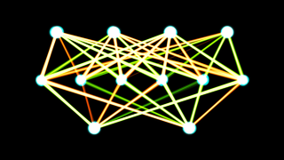
#P2: Co-Creating with market / end user (Document Bot - Subtl.ai & SBI)
Upload your enterprise docs
Documents auto-Modeled
Ask your questions in natural language
SaaS platform
Natural Language Understanding
Cognitive Question Answering
Document Information Retrieval
Domain-focused models

Slide 15
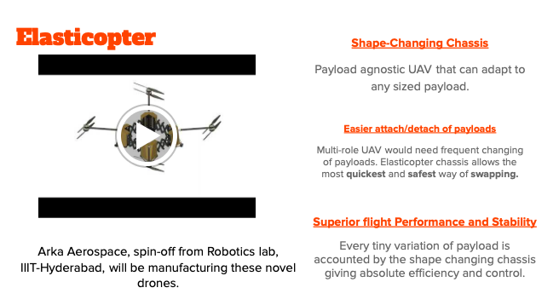

#P3: Shaping Student innovation ( Elasticopter - ArkaAerospace)

Slide 16
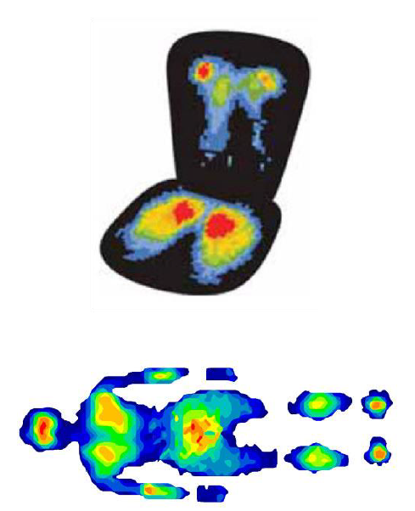
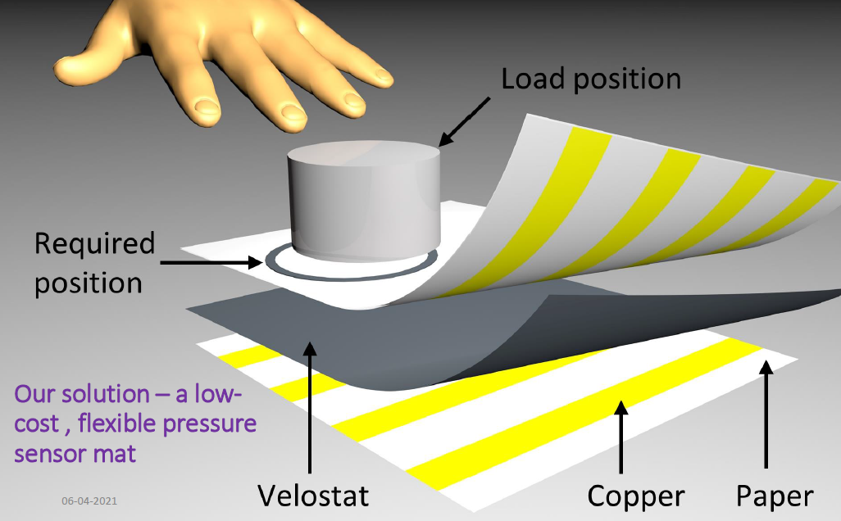
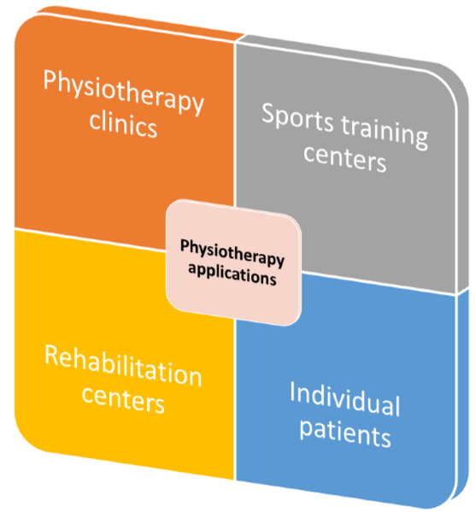
#P4: Multi Application hardware platform (Sensor Mat)

Slide 17


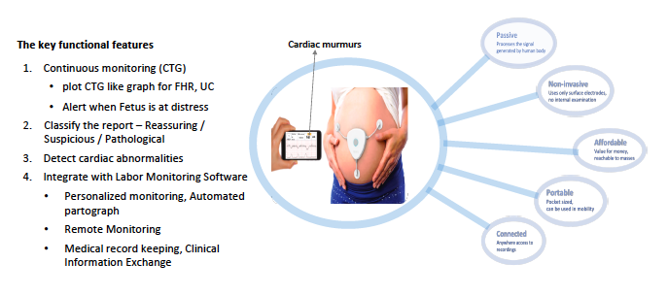

#P5: Co-Creating with startup (BP meter & Labor Monitoring )
Novel Blood Pressure estimation using features extracted from
ECG and PPG signals

Slide 18
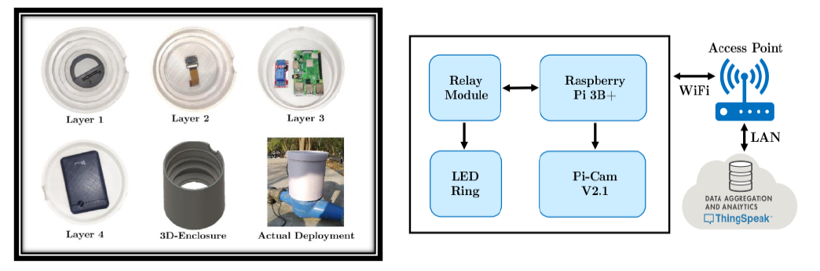
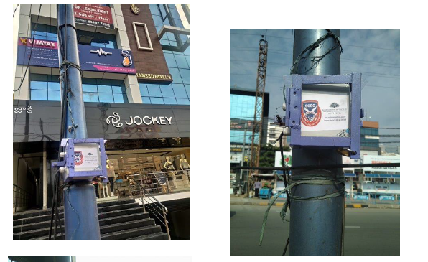
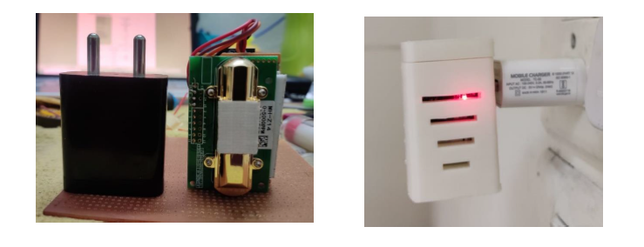
#P6: Living Lab (Meity Project ) to Startup
Water monitoring Retrofit
Outdoor Pollution
Indoor Pollution

Slide 19
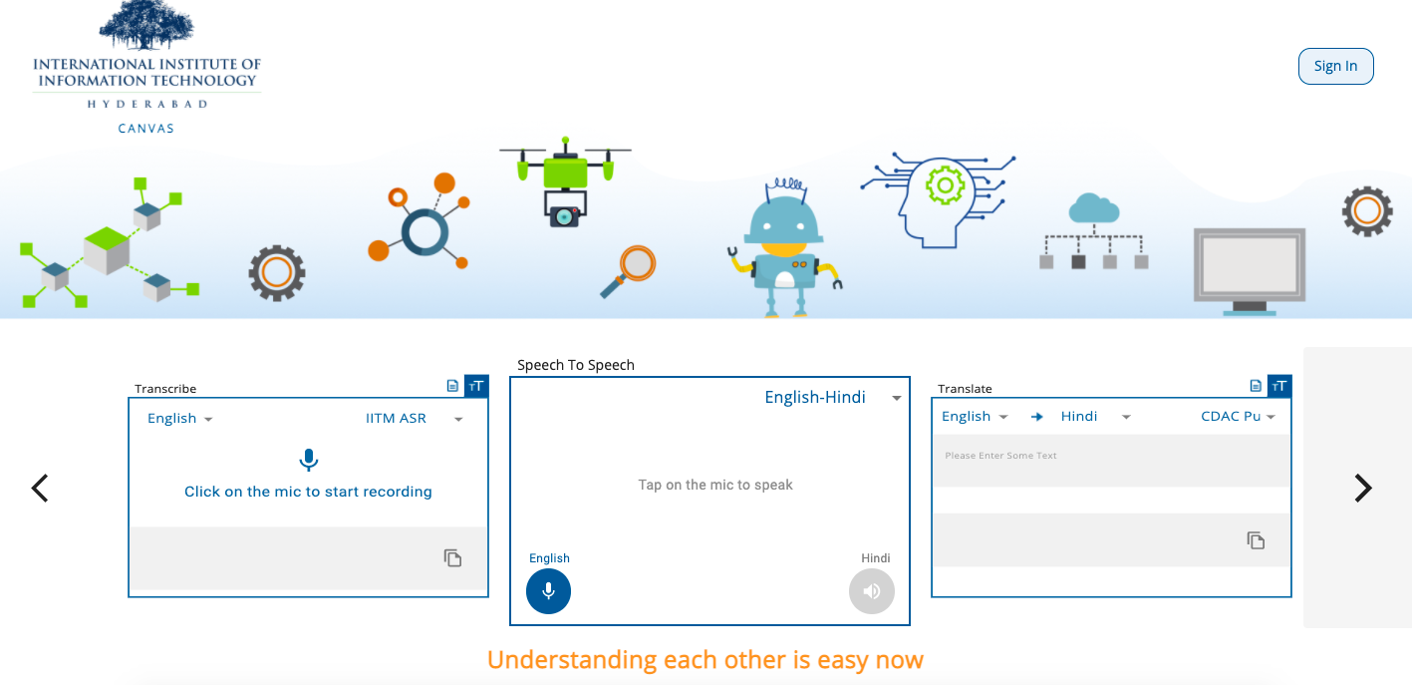
#P7: Monetizing Using APIs (Meity Bhashini Program)

Slide 20

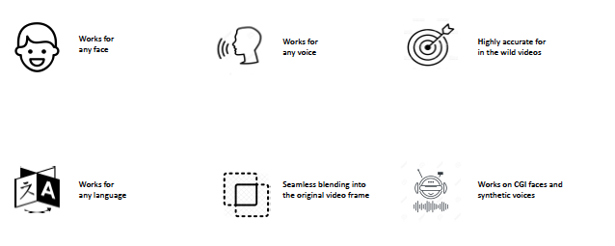

#P8: Virtual Startup Model (DeepSync)

Slide 21

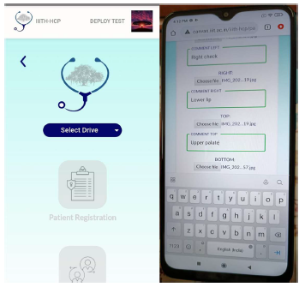


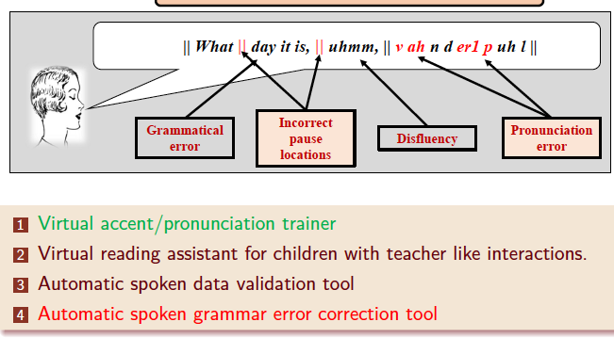
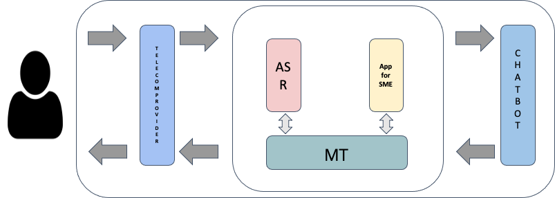
#P9: Social Innovations
Language Proficiency Enablement
HealthCare Screening Data Collection
AskAgastya – Student Q&A System

Slide 22
Proven Approaches in place to Inject innovation Into deep-tech

Slide 23
Thanks

